Slide 1
ANZ Virtual Internship Program
Task 1
Exploratory Data Analysis Report
By
Aritra Bhattacharya

Slide 2
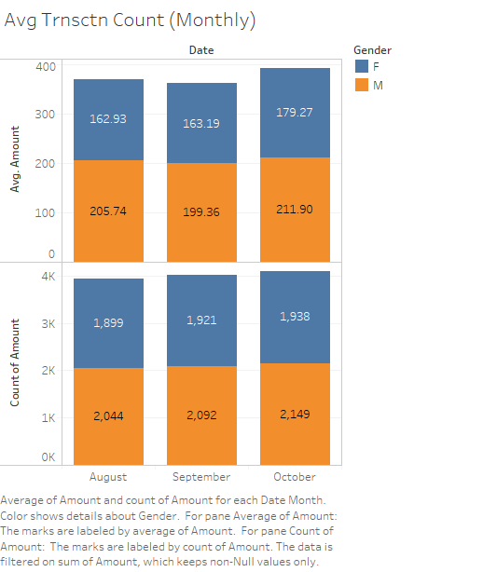
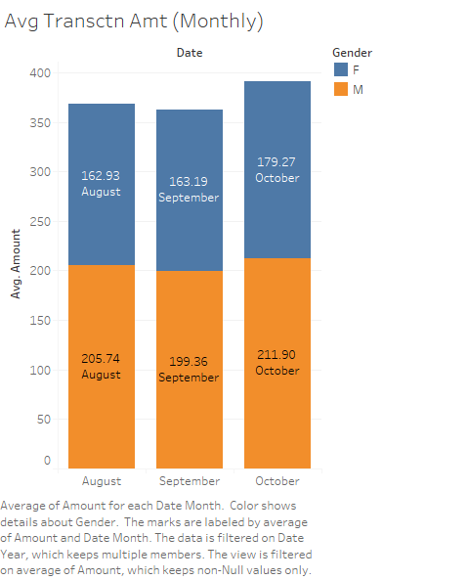
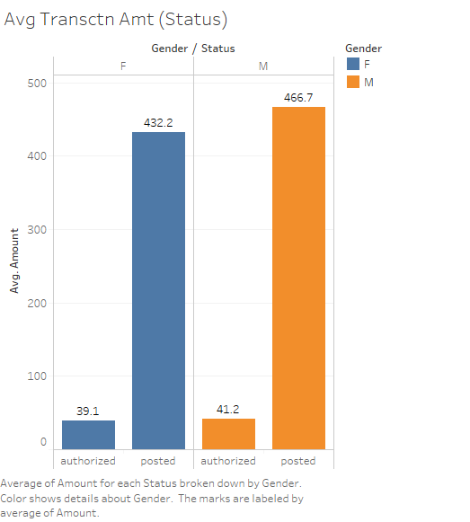

Slide 3
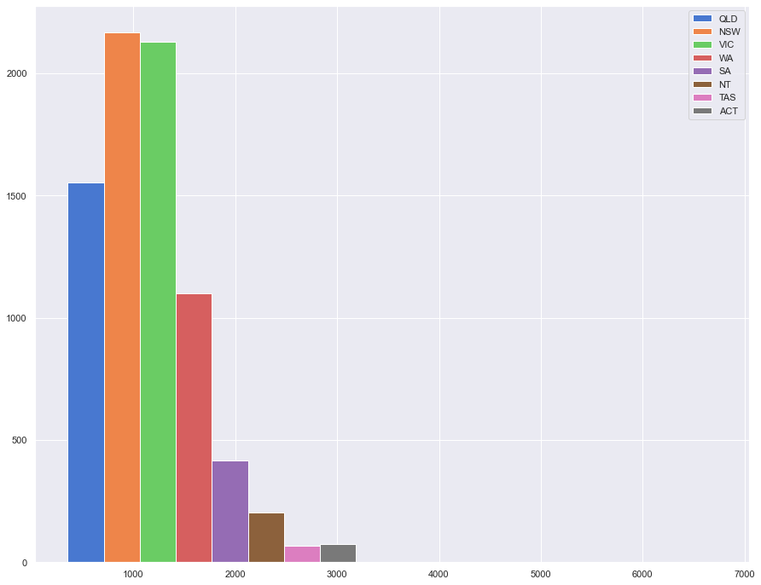
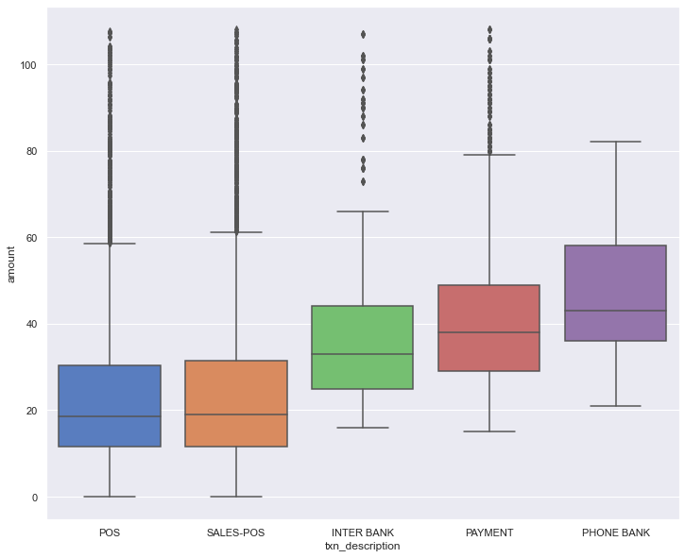
Histogram Plot showing the relation between Transaction amount against Merchant states
Boxplot showing the volume and spending over the course of the 3 months on an average

Slide 4
Insights:
The histogram plot in slide 3 shows the state of New South Wales having the most occurrences of merchant activities against payments followed by Victoria.
The lowest number of occurrences is from the state of Tasmania followed by the states of Australian Capital Territory.
Number of transaction records amounting up to more than 2000 AUD is observed from the state of New South Wales whereas the lowest number of transaction is observed by the state of Tasmania.
Differences between Tasmania and the ACT in merchant activities is almost negligible suggesting that the results may vary over time and probably may also change along with time. This is also applicable for the highest activity recorded states of the country.

